Slide 1
Electrical Potential and Potential Difference

Slide 2
Summary from yesterday
What is electric charge?
What is electrical current?
What is Coulomb’s law?

Slide 3

$$I=\frac{q}{t}$$
I is current (Amperes)
q is charge (Coulombs)
t is time (seconds)

Slide 4
What do electrical circuits do?
Put simply, they enable electrical energy to be transferred and transformed into a range of other useful forms of energy, such as kinetic energy, thermal energy or light.
Energy is conserved in these transfers and transformations!

Slide 5
Electrical potential
Electrical potential is a location-dependant quantity that expresses the amount of energy per unit of charge at a specific location.
When a Coulomb of charge (or any given amount of charge) possesses a relatively large quantity of potential energy at a given location, then that location is said to be a location of high electric potential.
And similarly, if a Coulomb of charge (or any given amount of charge) possesses a relatively small quantity of potential energy at a given location, then that location is said to be a location of low electric potential.
Charges will move if there is a difference in potential between two positions in a circuit.

Slide 6
Potential difference
Consider moving a charge from location A to location B;
To move this charge, work will have to be done on the charge by an external force.
The work done on the charge changes its potential energy to a higher value; and the amount of work that is done is equal to the change in the potential energy.

Slide 7
Potential difference
As a result of this change in potential energy, there is also a difference in electric potential between locations A and B.
This difference in electric potential is referred to as the electric potential difference.
It is also called the Voltage

Slide 8
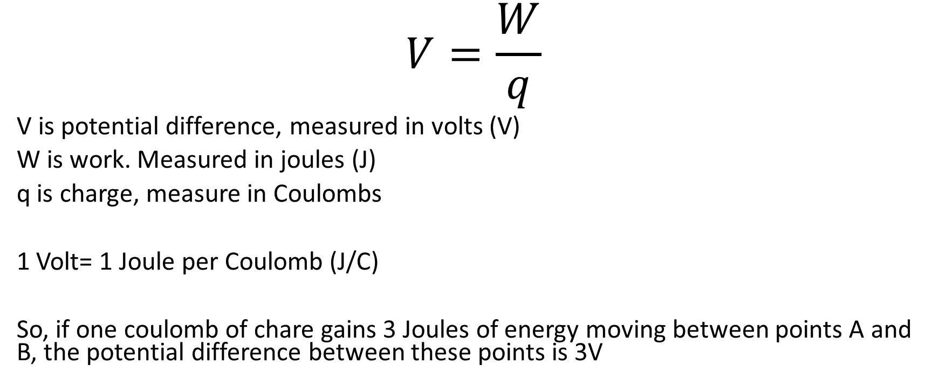
$$V=\frac{W}{q}$$
V is potential difference, measured in volts (V)
W is work. Measured in joules (J)
q is charge, measure in Coulombs
1 Volt= 1 Joule per Coulomb (J/C)
So, if one coulomb of chare gains 3 Joules of energy moving between points A and B, the potential difference between these points is 3V

Slide 9
I finally managed to get rid of that nasty electrical charge I've been carrying.
I'm ex-static!

